Slide 1
Welcome class ☺
28th November 2023

Slide 2
Classroom rules
Be respectful towards other people, other people’s property and the school’s property.
No drinking or eating in class (with the exception of water).
Mobile phones turned off and inside the phone pouches.

Slide 3
Lesson goal
You can use your knowledge of unit 2 (vocabulary and grammar) to do the exercises in the WikiWijs.

Slide 4
Lesson programme
Revision unit 2 - Vocabulary Technology Word list (p. 26) - Grammar Present Continuous (p. 27) Present Continuous and Present Simple (p. 130)

Slide 5
Lesson programme
Revision unit 3 - Vocabulary School and education Word list (p. 39) - Grammar Past Simple (p. 38)

Slide 6
WikiWijs
• Do all the activities (in the given order!)
Introduction*
Vocabulary (2 multiple choice exercise)*
Grammar (3 gap filled exercises)*
Exit ticket*
Extra practice (2 educational games)
Activity with an asterisk (*) → You must do this activity.

Slide 7
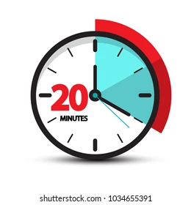
WikiWijs
• Click on this link to access the WikiWijs on Unit 2.
https://maken.wikiwijs.nl/201560/Unit_2
• You can work together, but you must speak on a low volume or whisper.

